Slide 1
KMP(Knuth Morris Pratt)
Algorithm
Muhamad Dani Setiawan
Muhammad Dava F
Natasha
2SC8

Slide 2
Background
Search engines developed business models to finance their services, such as pay per click programs offered by Open Text in 1996 and then Goto.com in 1998
Some of the Search Engines also add features such as Word Suggestion, is the feature that gives the closest suggestion to the word we want to find. In making this feature a string matching algorithm is used. Examples of these String Matching algorithms include Brute Force, Knuth-Morris-Pratt, Boyer-Moore, Karp-Rabin, etc.

Slide 3
ALGORITHM
Blla blalasdmsadksmadk Hardware is a set of components in a computer whose job is to make the computer work. Or in other words hardware can also mean computer devices that can be touched, the contents are related to computer work systems.

Slide 4
DATA
STRUCTURES
Data structure is a procedure for storing, compiling, and analyzing data so the data can be used efficiently. Data structure is not only where the part is stored but how the relationship between one data and another.

Slide 5
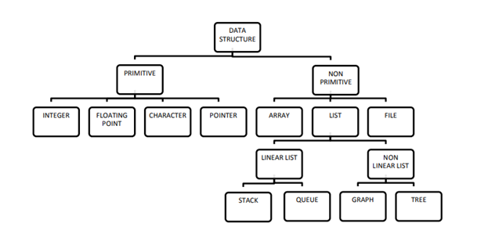
Classification of Data Structures

Slide 6
Classification of Data Structures
Non-Primitive data structure is more sophisticated data structures, this is derived from primitive data structures. emphasize on structuring of a
group
homogeneous
data items.
Nonlinear data structures are those data structure in which data items are not arranged in a sequence. Examples of Non-linear Data Structure are Tree and Graph.
PRIMITIVE
LINEAR DATA
Primitive data structures are basic structures and are directly operated upon by machine instructions, it has different representations on different computers.
A data structure is said to be Linear,
if its elements
are connected in linear fashion by means of logically Examples of Linear Data Structure are Stack and Queue.
.
NON-PRIMITIVE
SOUNON-LINEAR
DATA
ND & VIDEO

Slide 7
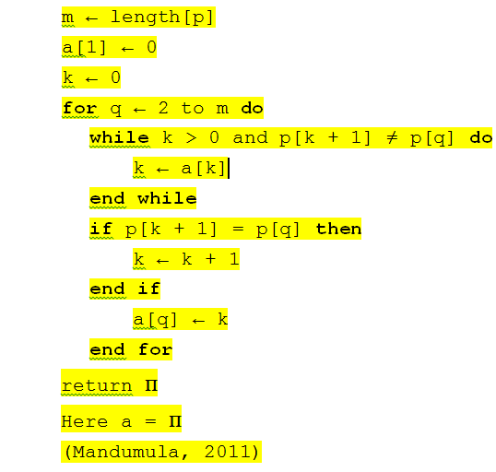
Component of KMP Algorithm
It preprocesses the pattern to find matches of prefixes of the pattern with the pattern itself
It is defined as the size of the largest prefix of P[0..j − 1] that is also a suffix of P[1..j].
It also indicates how much of the last comparison can be reused if it fails.
It enables avoiding backtracking on the string ‘S’

Slide 8
How Knuth-Morris-Pratt Works

Slide 9
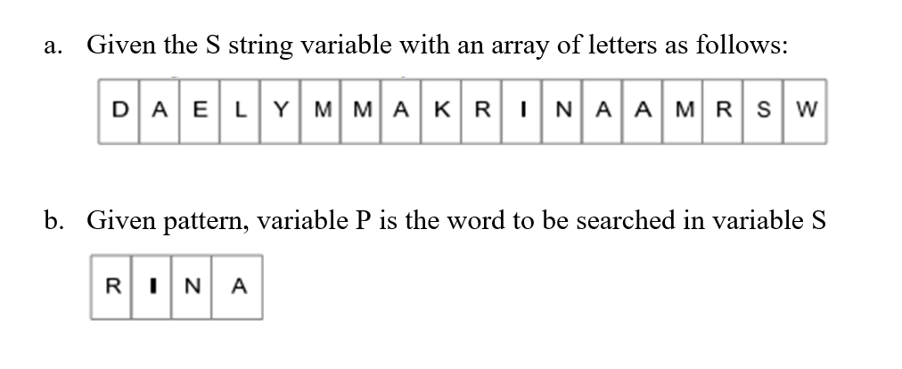

Slide 10
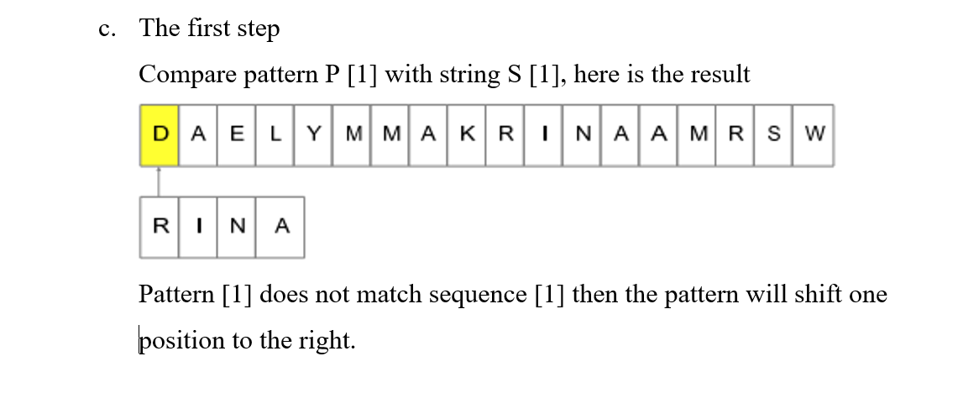

Slide 11
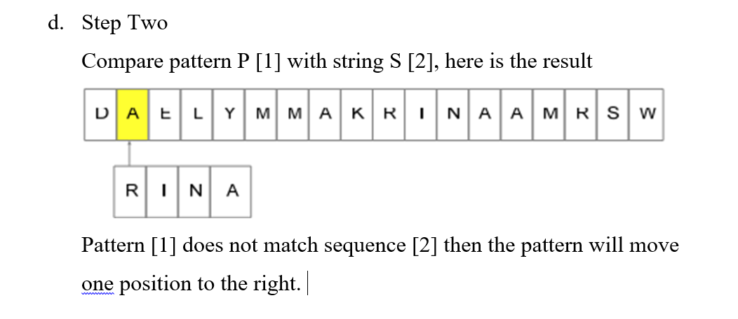

Slide 12
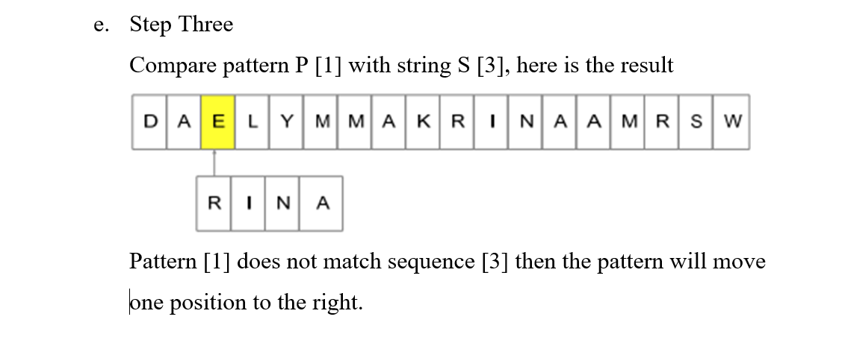

Slide 13
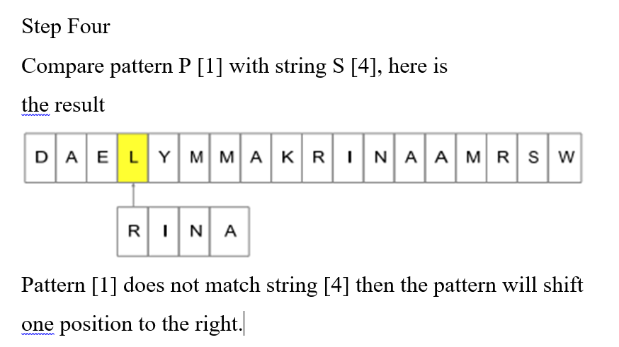

Slide 14
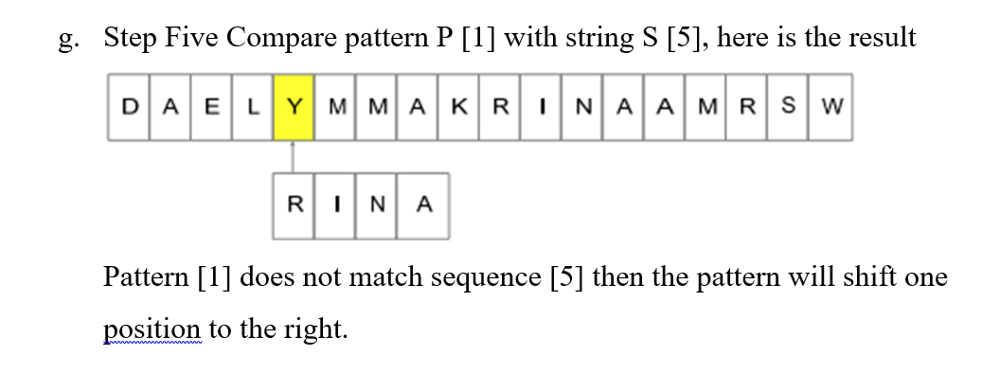

Slide 15
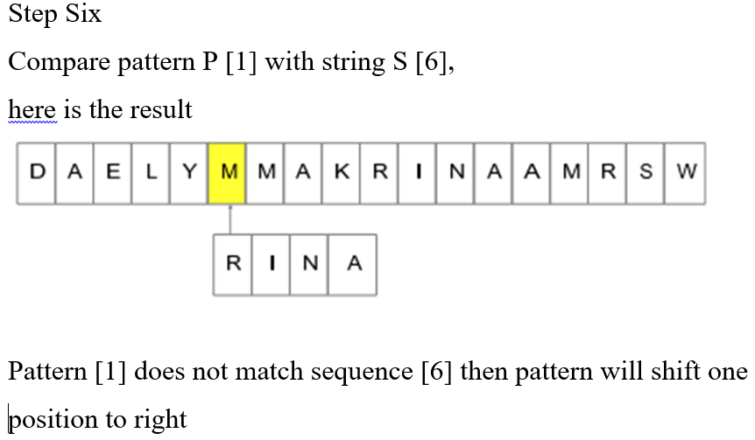

Slide 16
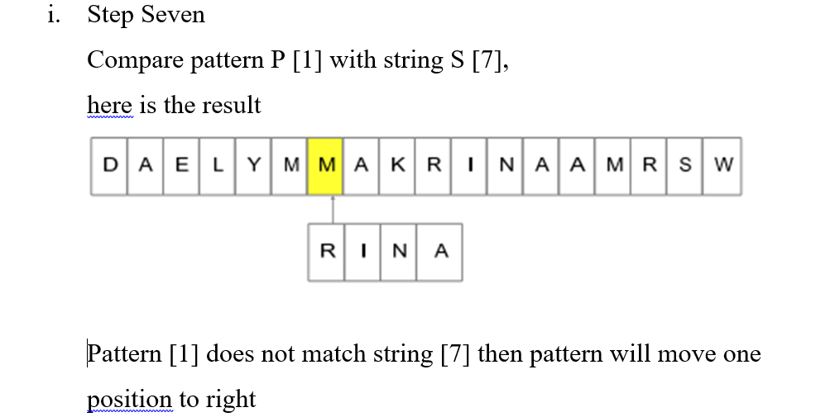

Slide 17
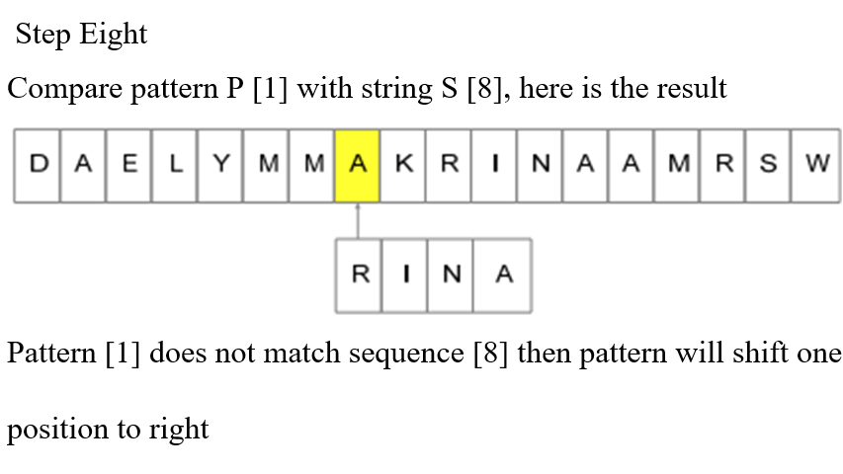

Slide 18
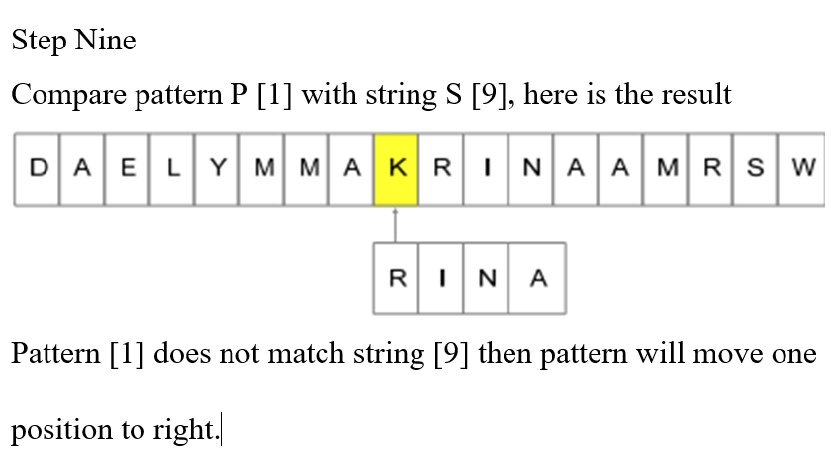

Slide 19
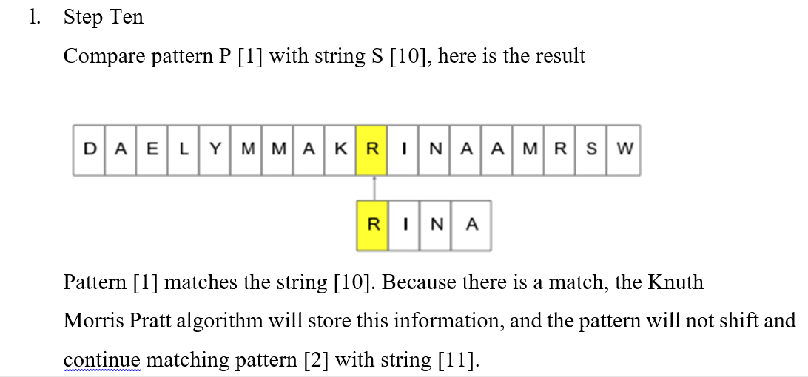

Slide 20
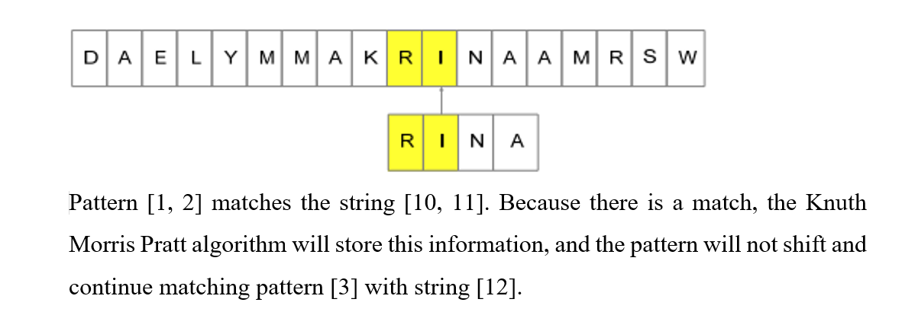

Slide 21
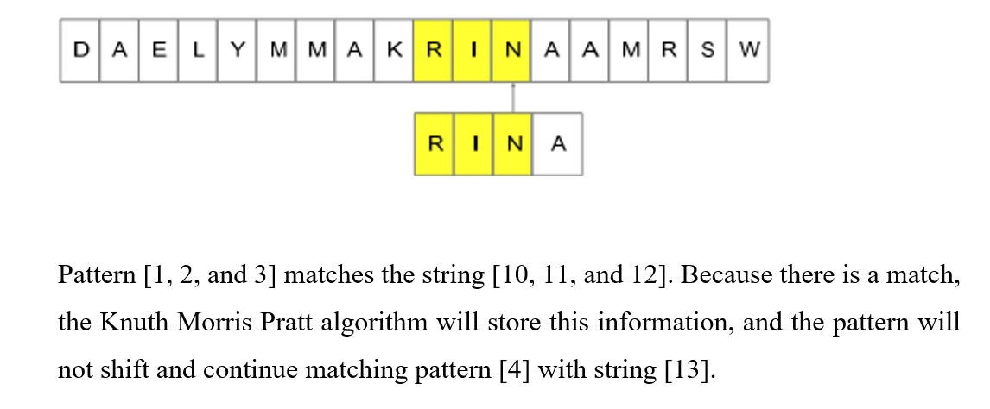

Slide 22
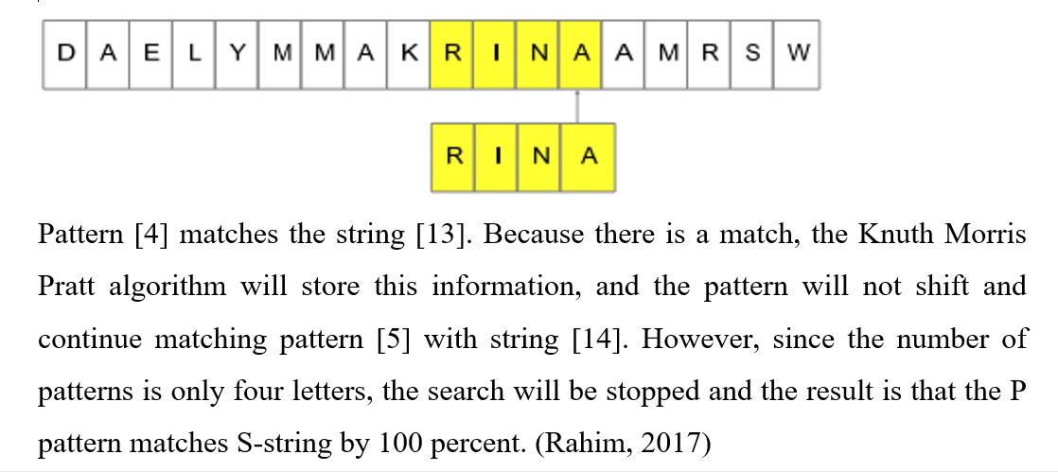

Slide 23
Run Time Analysis
1
2
3
O(m) - It is to compute the prefix function values.
O(n) - It is to compare the pattern to the text.
Total of O(n + m) run time. (Mandumula, 2011)

Slide 24
Advantages and Disadvantages
ADVANTAGES
DISADVANTAGES
Doesn’t work so well as the size of the alphabets increases. By which more chances of mismatch occurs. (Mandumula, 2011)
The running time of the KMP algorithm is optimal (O(m + n)), which is very fast.
The algorithm never needs to move backwards in the input text T. It makes the algorithm good for processing very large files. (Mandumula, 2011)

Slide 25
THANK YOU FOR ATTENTION
ANY QUESTIONS? ☺

